Slide 1

Smart Fertilizer Spraying System Using Plant Disease Severity Analysis
Smart Fertilizer Spraying System Using Plant Disease Severity Analysis
by
Y Trinesh Reddy
Roll No. 234G5A3311
G Sreeja
Roll No. 224G1A33A9
B Revathi
Roll No. 224G1A3380
Y Sravani
Roll No. 224G1A33A4
Under the guidance of
Dr. C. Sasikala M.Tech., Ph.D.
Associate Professor
Department of Computer Science and Engineering (AI & ML)
Srinivasa Ramanujan Institute of Technology
(Affiliated to JNTUA & Approved by AICTE) (Accredited by NAAC with ‘A’ Grade & Accredited by NBA (EEE, ECE & CSE)
Rotarypuram Village, B K Samudram Mandal, Ananthapuramu – 515701.
2025 - 2026
B-10
Srinivasa Ramanujan Institute of Technology 1

Slide 2
Contents
Abstract
Introduction
Problem statement
Objectives
Methodology
Implementation details
Expected outcomes / Results
Budget estimation
B-10
Srinivasa Ramanujan Institute of Technology
2

Slide 3
Abstract
The Smart Fertilizer Spraying System with Plant Disease Severity Analysis is an automated agricultural robot designed to enhance crop management through precision farming. The system employs a Raspberry Pi equipped with a USB camera to capture plant images and analyze disease severity using advanced image processing techniques. Based on the detected severity levels, the system dynamically regulates fertilizer spraying duration through three dedicated nozzles, ensuring precise application and minimizing wastage.
An Arduino microcontroller manages the operation of DC motors, water pumps, relays, and the robot chassis for efficient movement. Powered by a 12V battery and supported by a 9V solar panel, the system offers sustainable and energy-efficient operation. Bluetooth connectivity facilitates wireless monitoring and control. By combining disease severity detection with intelligent fertilizer management, this system reduces human intervention, optimizes resource utilization, and promotes eco-friendly farming practices
B - 10
Srinivasa Ramanujan Institute of Technology
4

Slide 4
Introduction
The Smart Fertilizer Spraying System with Plant Disease Severity Analysis is an automated agricultural robot developed to improve crop management through precision farming. The system uses a Raspberry Pi integrated with a USB camera to capture plant images and analyze disease severity using advanced image processing techniques. Based on the detected severity levels, the system automatically controls the fertilizer spraying process by adjusting the spray duration through three dedicated nozzles, ensuring accurate application while minimizing fertilizer wastage.
An Arduino microcontroller manages the robot’s movement and controls hardware components such as DC motors, water pumps, relays, and the chassis to enable efficient field navigation. The system is powered by a 12V battery supported by a 9V solar panel, providing sustainable and energy-efficient operation. Bluetooth connectivity allows wireless monitoring and control of the system. By integrating plant disease severity detection with intelligent fertilizer management, the proposed system reduces human intervention, optimizes resource utilization, and promotes eco-friendly and sustainable agricultural practices.
Srinivasa Ramanujan Institute of Technology

Slide 5
Problem statement
Plant diseases significantly reduce crop yield and quality, directly affecting farmers income and overall agricultural productivity. Traditional disease monitoring and fertilizer spraying methods are manual, time-consuming, and labor-intensive. Farmers often apply fertilizers or pesticides uniformly across the field without assessing the actual severity of infection. This results in chemical wastage, increased operational costs, and environmental pollution. Continuous monitoring of large agricultural fields is also difficult and inefficient.
Therefore, there is a need for an intelligent and automated system that can detect plant diseases in real time, analyze their severity accurately, and spray fertilizer precisely where required. The proposed Smart Fertilizer Spraying Robot aims to support precision agriculture, reduce human effort, minimize chemical usage, and promote sustainable and efficient farming practices.
Srinivasa Ramanujan Institute of Technology
6

Slide 6
Objectives
The main objective of this project is to design and develop a smart robotic system for automatic crop monitoring and plant disease management. The system aims to detect plant diseases in real time using image processing techniques and calculate the percentage of infected area to determine the severity level. Based on the severity analysis, the robot will automatically control fertilizer spraying to ensure precise and need-based application. Another objective is to reduce chemical wastage and minimize environmental impact through controlled spraying. The project also focuses on integrating Raspberry Pi for image processing and Arduino for motor and pump control to ensure efficient system operation. Smooth robotic navigation across plant rows and wireless monitoring through Bluetooth communication are included to enhance usability. Additionally, the system ensures efficient power management using a rechargeable battery. Overall, the project aims to improve agricultural productivity through automation and precision farming techniques.
Srinivasa Ramanujan Institute of Technology

Slide 7
Methodology
The Smart Fertilizer Spraying Robot begins its operation by initializing all hardware components including the Raspberry Pi, Arduino, USB camera, DC motors, water pump, relay module, Bluetooth module, and rechargeable battery. Proper communication is established between the Raspberry Pi and Arduino for coordinated functioning. As the robot moves along the crop rows, the camera captures real-time images of the plants. These images are processed by the Raspberry Pi using preprocessing techniques such as resizing, noise removal, and color conversion to enhance image quality.
Image segmentation and thresholding methods are then applied to detect infected regions and calculate the percentage of affected area. Based on the severity level (Low, Medium, or High), control signals are sent to the Arduino to regulate the pump and adjust the spraying duration accordingly. If no disease is detected, the robot continues its movement without spraying. This integrated process ensures accurate disease detection, precise fertilizer application, and efficient coverage of the agricultural field.
Srinivasa Ramanujan Institute of Technology

Slide 8
Implementation details
The Smart Fertilizer Spraying Robot is implemented using an integrated Raspberry Pi and Arduino architecture. Plant disease detection is performed using YOLOv8, which enables fast and real-time object detection instead of using a traditional CNN model. A custom dataset of plant images is collected and trained, achieving approximately 80% detection accuracy.
The Raspberry Pi processes images captured from the camera and determines the disease severity level. Based on the severity classification, control signals are sent to the Arduino for spraying action. The fertilizer spraying system is controlled using a relay module that activates the water pump. The spraying duration is set according to severity levels: High severity – 7 seconds, Medium severity – 5 seconds, and Low severity – 2 seconds.
Bluetooth communication is used to interact with the Arduino for wireless control and monitoring. For interfacing and accessing the Raspberry Pi remotely, VNC Viewer is used to execute and monitor the YOLOv8 detection model. This implementation ensures precise spraying, real-time detection, and efficient coordination between hardware and software components.
Srinivasa Ramanujan Institute of Technology

Slide 9
Expected outcomes / Results
The expected outcome of this project is the successful development of a Smart Fertilizer Spraying Robot capable of detecting plant diseases in real time using the YOLOv8 model with approximately 80% accuracy. The system should accurately identify infected plants and classify disease severity into Low, Medium, and High categories based on the affected area.
Based on the severity level, the robot will automatically control fertilizer spraying duration—2 seconds for Low, 5 seconds for Medium, and 7 seconds for High severity—using a relay-controlled pump mechanism. This ensures precise and need-based fertilizer application, reducing chemical wastage and environmental impact.
The robot is expected to move smoothly across plant rows while continuously monitoring crops. Wireless communication through Bluetooth and remote monitoring via VNC Viewer will allow effective system control. Overall, the project aims to improve crop health, reduce manual effort, minimize operational costs, and enhance agricultural productivity through automation and precision farming.
Srinivasa Ramanujan Institute of Technology

Slide 10
Components
Hardware Components:
Raspberry pi
Memory card
Usb web camera
Arduino
Solar panel 9v
Led
Dc motor 2
Robot chassis
Wheels-4
dc water pump-3
motor driver
relay-3
nozzle spraying-3
Bluetooth module
12v Battery
12v Adapter 2 amp
Software Components:
Arduino IDE
Embedded C
python
B-10
Srinivasa Ramanujan Institute of Technology

Slide 11
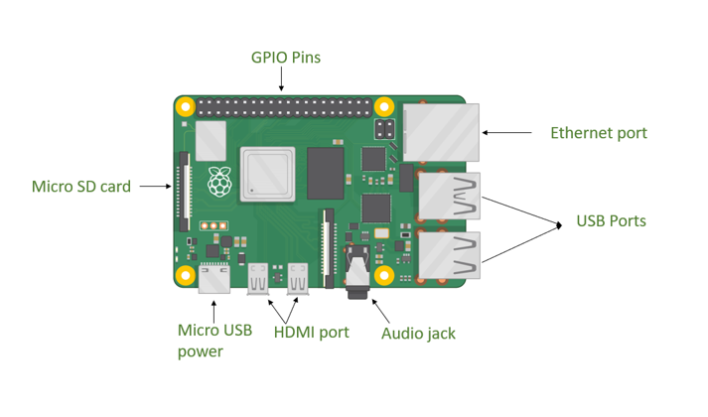
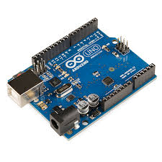
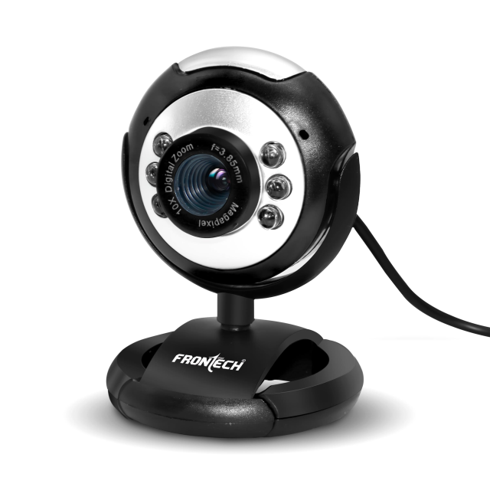
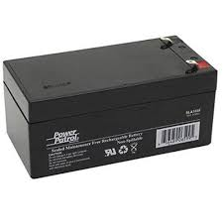
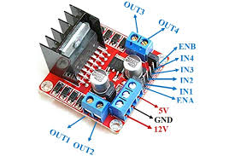
Components
Raspberry Pi
Web cam
Arduino Uno
Raspberry Pi:
12v Battery
Motor Driver
Srinivasa Ramanujan Institute of Technology

Slide 12
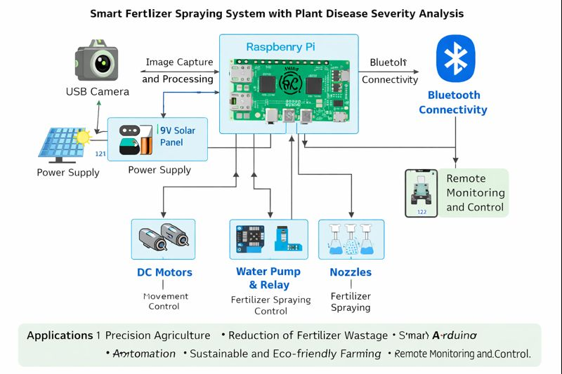
Block Diagram
Srinivasa Ramanujan Institute of Technology

Slide 13
Non-Recurring Budget estimation
S. No | Item Head | Estimated Cost (Rs.) | Fund Arranged by Students / Other Sources (Rs.) | Fund Required from Institute (Rs.)
1 | Raspberry Pi 4 Model B | 5,000 | 2,500 | 2,500
2 | Arduino UNO R3 | 2,300 | 1,200 | 1,100
3 | USB Camera Module | 1,500 | 800 | 700
4 | DC Motors with Wheels | 2,000 | 1,000 | 1,000
5 | Motor Driver Module (L298N) | 800 | 400 | 400
6 | Water Pump with Pipes & Nozzles | 1,500 | 800 | 700
7 | Relay Module | 1,000 | 500 | 500
8 | Bluetooth Module | 600 | 300 | 300
9 | 12V Battery | 1,800 | 900 | 900
10 | Solar Panel | 2,000 | 1,000 | 1,000
11 | Robot Chassis & Frame | 1,500 | 800 | 700
12 | Jumper Wires & Connecting Cables | 500 | 300 | 200
13 | Breadboard & PCB | 600 | 350 | 250
14 | Fertilizer Tank | 1,000 | 500 | 500
Srinivasa Ramanujan Institute of Technology

Slide 14
Recurring Budget estimation
S. No | Item Head | Estimated Cost (Rs.) | Fund Arranged (Rs.) | Fund Required (Rs.)
1 | Manpower | 1,000 | 800 | 200
2 | Consumables | 1,000 | 700 | 300
3 | Contingencies | 500 | 350 | 150
4 | Travel & Field Testing | 900 | 700 | 200
5 | Overhead Charges | 500 | 400 | 100
Srinivasa Ramanujan Institute of Technology

Slide 15
Budget estimation
Subtotal (Non-Recurring)
Estimated Cost: Rs. 22,100
Arranged by Students: Rs. 11,350
Fund Required from Institute: Rs. 10,750
Subtotal (Recurring Items)
Estimated Cost: Rs. 3,900
Arranged by Students: Rs. 2,950
Fund Required from Institute: Rs. 950
Grand Total (A + B)
DescriptionAmount (Rs.)Total Estimated Cost 26,000
Total Arranged by Students 14,300
Total Fund Required from Institute 11,700
Srinivasa Ramanujan Institute of Technology

Slide 16
Reference
Prakash M. Manikar, Shreekant Ghorpade, Mayur Adawadkar, "Plant Leaf Disease Detection and Classification Using Image Processing Techniques," International Engineering Journal, Volume 2, Issue 4, 2015.
2 Prof. Bhavana Patil, Mr. Hemant Panchal, Mr. SHUBHAM Yadav, Mr. Arvind Singh, Mr. Dinesh Patil, "Plant Monitoring Using Image Processing, Raspberry PI and IOT," Journal of Engineering and Technology, Volume 4, Issue 10, 2017
3 Navin V. Dumare, Prof. S. S. Mungona, "Identification of Cotton Leaf Diseases Using Raspberry PI," Volume 5, Issue 5, 2017, International Journal on Recent and Technology Trends in Computing and Communication.
Prathamesh. K. Kharde, Hemangi. H. Kulkarni, "A Special Method for the Detection of Grape Leaf Diseases," International Journal of Scientific Research, Volume 2, Issue 4, 2016.
Jayaprakash Sethupathy, Veni S, International Journal of Engineering and Technology, Volume 8, No 5, 2016, "Open CV Based Disease Detection of Mango Leaves."
Srinivasa Ramanujan Institute of Technology

Slide 17
Applications
Precision Agriculture – Automatically applies the right amount of fertilizer based on plant disease severity, improving crop health and yield.
Reduction of Fertilizer Wastage – Prevents overuse of fertilizers by spraying only where and when needed, saving cost and resources.
Smart Farming Automation – Reduces manual labor by automating disease detection, fertilizer spraying, and robot movement in agricultural fields.
Sustainable and Eco-friendly Farming – Uses solar power and optimized fertilizer usage to promote environmentally friendly agricultural practices.
Remote Monitoring and Control – Allows farmers to wirelessly monitor and control the fertilizer spraying system via Bluetooth for easy operation and decision-making.
B-10
B-10
Srinivasa Ramanujan Institute of Technology

Slide 18
Conclusion
The Smart Fertilizer Spraying System with Plant Disease Severity Analysis presents
an effective and innovative solution for modern precision agriculture. By
integrating image-based plant disease severity detection with automated fertilizer
spraying, the system ensures accurate and need-based application of fertilizers,
thereby reducing wastage and improving crop health. The coordinated operation of
the Raspberry Pi for image processing and the Arduino microcontroller for
hardware control enables efficient robot movement and reliable system
performance.
The use of solar-assisted power enhances sustainability, while
Bluetooth connectivity provides convenient wireless monitoring and control.
Overall, this system minimizes human intervention, optimizes resource utilization,
and supports eco-friendly farming practices, making it a promising approach for
improving agricultural productivity and sustainability in real-world farming
environments.
Srinivasa Ramanujan Institute of Technology

Slide 19
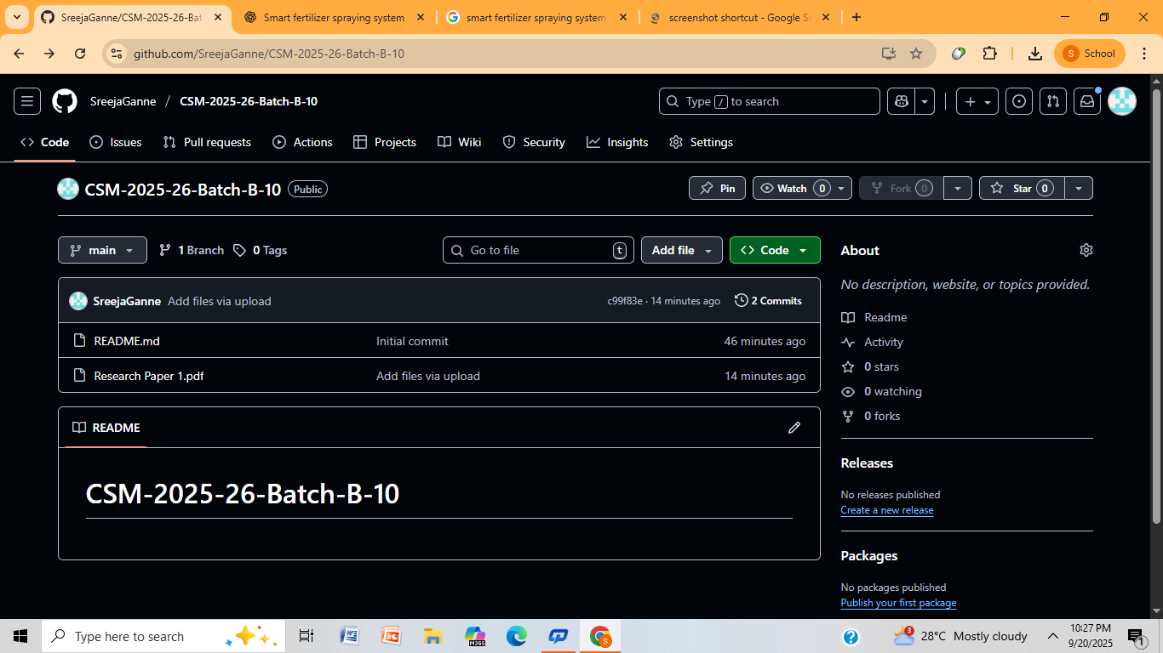
Git Hub Dashboard
Srinivasa Ramanujan Institute of Technology

Slide 20
Any Queries?
Srinivasa Ramanujan Institute of Technology

Slide 21
Thank You!!!
Srinivasa Ramanujan Institute of Technology

